Slide 1
Coders Club
Department of Computer Science and Engineering
Dayananda Sagar University
NPM, Express and Express MVC

Slide 2
Learning Objective
Understanding of the following
Node Package Manager (NPM)
ExpressJS Framework
Problems on ExpressJS
Express MVC
Problems on Express MVC
Coders Club

Slide 3
Node Modules
Node comes with some of the modules which are known as Built in modules and these can be used without installing. Egs. event, fs, http
Any other modules other than Built in modules are user defined modules. These modules are either to be developed or to be installed.
Modules can be installed using Node Package Manager(NPM).
Coders Club

Slide 4

Installation of NPM
For windows npm comes bundled with node installer.
For Linux ‘sudo apt install npm’ installs npm.
To verify installation of npm type ‘npm –v’
Which should print the version of npm installed.
This verifies the installation of npm.
Packages are to be installed using CLI
Syntax: npm install <package_name> -g
Coders Club

Slide 5
Express JS
Express is a backend web application framework.
Used to develop web applications and APIs.
In NodeJS application, developers need to manage routing.
Express will free developers from routing.
Express JS is relatively minimal with many features available as plugins.
Coders Club

Slide 6
Express is to be installed before starting with development of express app.
Express can be installed with command ‘npm install express’.
Once installed to include it we need to require express. Which can be done as shown below.
express = require(‘express’)
Coders Club

Slide 7
Problems
Write a express app to return hello world
localhost:9001/ HelloworldEx.js
Write a express app which accepts name as routing params and returns Welcome <name> localhost:9001/name WelcomeEx.js
Write a express app which accepts operands as routing params and returns the sum
localhost:9001/a/b AddEx.js
Write a express app which accepts a number as routing params and return the word equivalent of the number
localhost:9001/n WordEx.js
Coders Club

Slide 8
Write a express app which returns Time in (HH:mm:ss)
localhost:9001/ TimeEx.js
Write a express app which returns Time in (HH:mm:ss) TimeEx.js
localhost:9001/ DateEx.js
Write a express app which searches a student from list of students by usn
localhost:9001/usn SearchEx.js
Coders Club

Slide 9
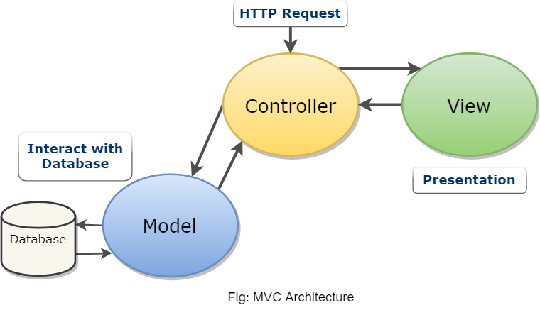
MVC Pattern
In this design pattern application consists of Model, View and controller. The pattern requires each of these be separated.
Coders Club

Slide 10
MVC, helps in separating the code, and gives a structure to the app.
Model contains logic of the application. It deals with database interaction. It has no idea how the data will be displayed.
View deals with the presentation of Model’s data.
Controller is responsible for flow of the application execution. It acts as a coordinator between Model and View
Coders Club

Slide 11
Problems on Express MVC
Write a express app to increment a counter Increment.js
Write a express app to collect student details Form.js
Write a express app to add two numbers Add.js
Write a express app to send html file and to send a image file SendFile.js
Coders Club

Slide 12
Summary
ExpressJS is used to create web applications and APIs.
Express can also be used to implement MVC web applications.
Coders Club

